Slide 1
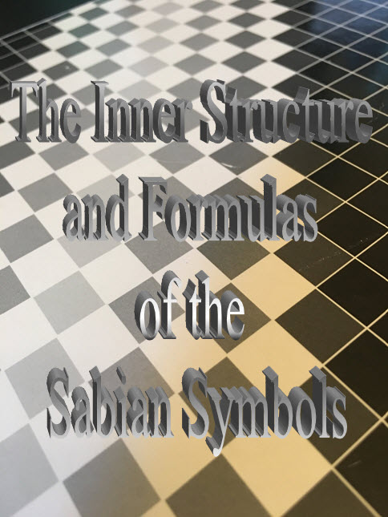

Slide 2
"To develop a complete mind, Study the science of art; Study the art of science; Learn to see; Realize that everything connects to everything else"
~ Leonardo da Vinci
TECHNIQUE
TOOLS
APPLICATION
ASPIRATION

Slide 3
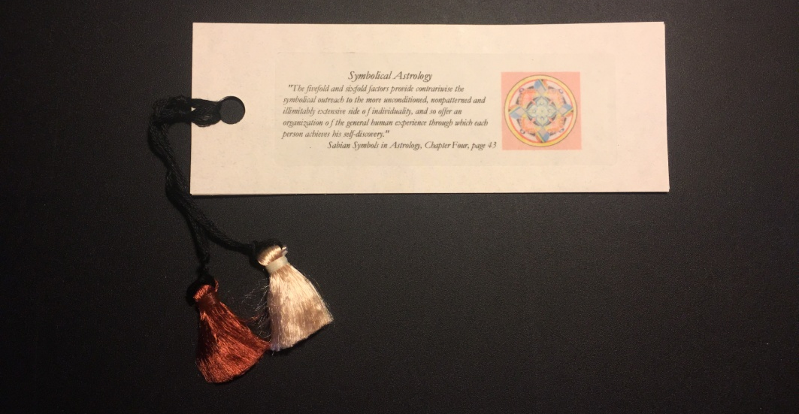
OBJECTIVES
ASTROLOGY
3-Fold and 4-Fold
The threefold and fourfold factors in the whole circle, or the quadratures and triplicities in their functional role, provide the rationale of the signs and houses. They Have become the established basis for all astrological charting of CHARACTER and delimitation of CIRCUMSTANCES.
SYMBOLICAL ASTROLOGY
5-Fold and 6-Fold
The fivefold and sixfold factors provide CONTRARIWISE the symbolical outreach to the more unconditioned, nonpatterned and illimitably extensive side of individuality, and so offer an organization of the general human experience through which each person achieves his self-discovery.

Slide 4
THE WORKBOOK

Slide 5
TECHNIQUE
Resources
Marc Edmund Jones: Sabian Symbols in Astrology ~ Symbolical Astrology
Dane Rudhyar: Wheel of Significance (from collection of magazine articles)

Slide 6
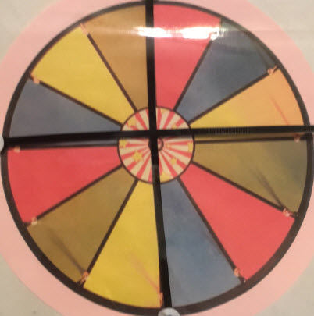
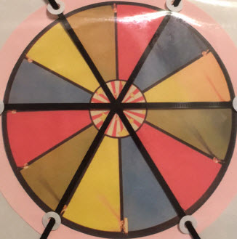
Comparison and Discussion
ASTROLOGY
SYMBOLICAL ASTROLOGY
Threefold and Fourfold Fivefold and Sixfold

Slide 7
But what does it all mean?????
Discuss the “DIY Workbooks”
Not to be learned in a day! But let’s go over a few main pointers…

Slide 8
The Formula

Slide 9
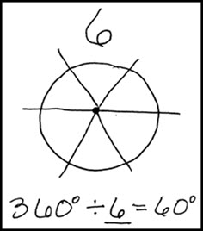

Slide 10
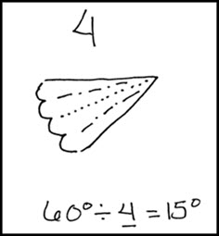

Slide 11
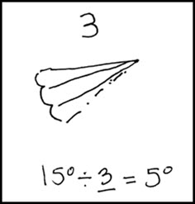

Slide 12
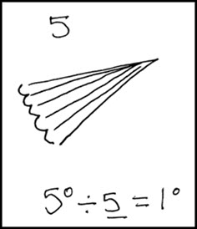

Slide 13
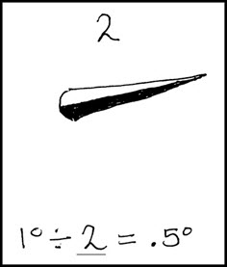
Marc gave every degree both a positive and a negative interpretation!
“…the freedom to bind or loose at will….”

Slide 14
DEGREES BY DESIGN
The Inner Structure

Slide 15
The Formulas
Hemispheres: Specializing (objective) 1-15 and Generalizing (subjective) 16-30
The Three Realms: Habit (physical), Social (emotional), and Spiritual (mental)
1-5 and 16-20 6-10 and 21-25 11-15 and 26-30
The Fivefold: Experimental, Sensitive, Receptive, Responsible, and Inspired
“Astrology is a science of relationships, and the frequently restated first key to its successful employment at any time is the realization that any factor or group of factors can be used absolutely, that is wholly of and by themselves.” Pythagorean Astrology
Z-q-t

Slide 16
DESIRE!
DEVOTION!
DILIGENCE!
DEDICATION!
DETERMINATION!

Slide 17
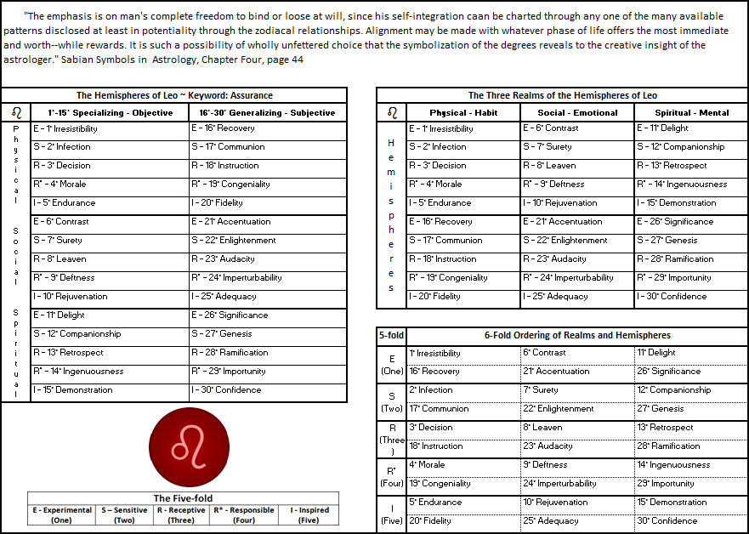
Let’s apply the formula to one sign, the Sign of Leo.

Slide 18
Tools to learn by…
Sabian Symbols in Astrology
Index cards
Dry Erase Board
Display
…
THE DECODER
TECHNOLOGY
THE FUTURE…

Slide 19
APPLICATION & ORGANIZATION
Now that we have access to learning and working with the Inner Structure and Formulas….
WHAT DO WE DO WITH IT ALL?
From Thingfulness to … Meaningfulness
Capturing documenting the life experience
Comparing the life experiences through the Inner Structure method
Recapitualizing, extracting, reflecting, …
What have I been up to? What possible joy could I be planning? What’s coming up next?

Slide 20
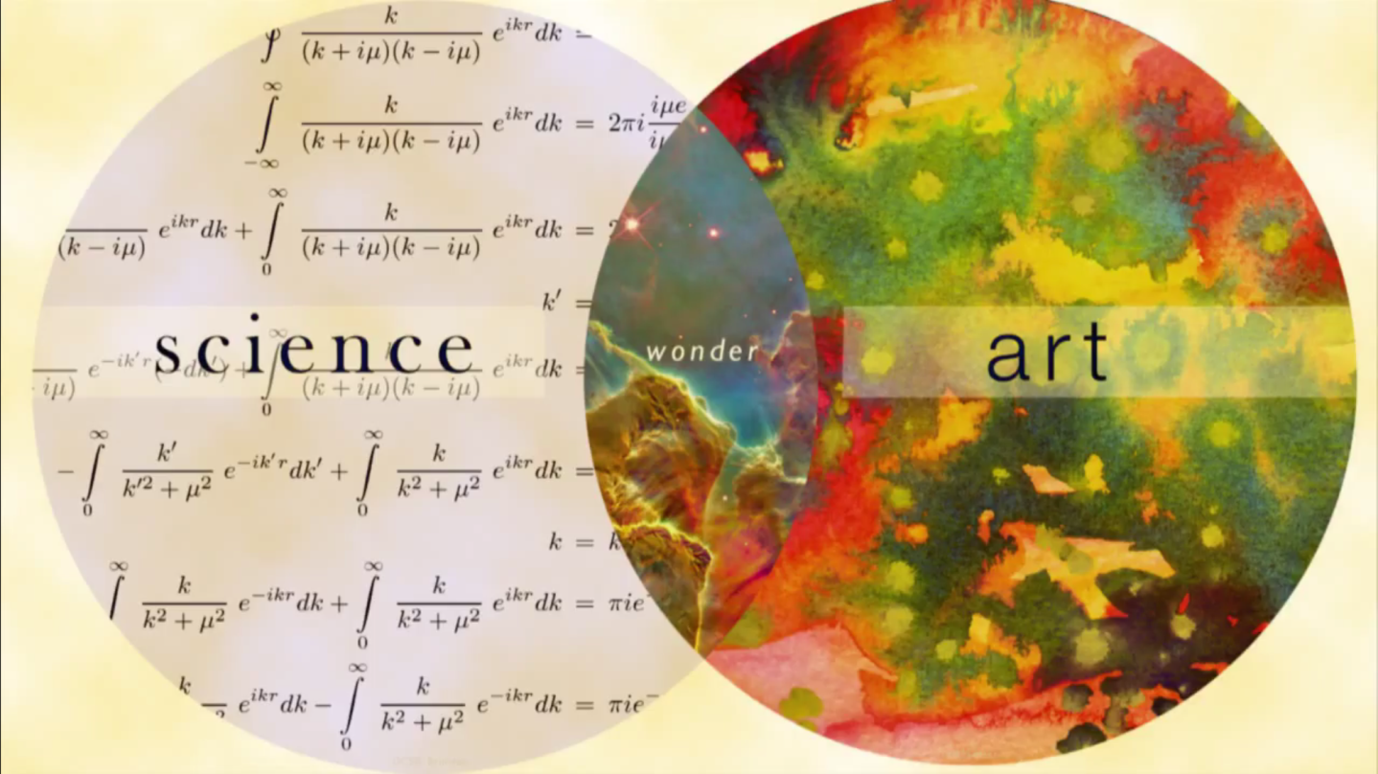
Aspiration
I invite you to join the Sabian Symbols Chapter!
We have time. We have space.
“Find something you love to do and work yourself to death at it.” MEJ

Slide 21
*No one else can do this for you! *Your inner experience is key! *We can share the journey! *We can encourage and support one another along the way! *Of ourselves our strength is nothing!

